Slide 1
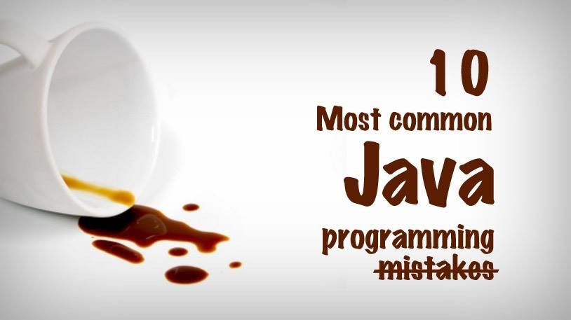

Slide 2
10 Common Mistakes Every Beginner Java Programmer Makes:
1. Accessing non-static members from static methods (mostly from the main method)
2. Missing closing curly braces
3. Missing break in switch case construct
4. Confusing assignment with comparison (= and ==)
5. Confusing object comparison (== instead of .equals)
6. Confusing about 0-based or 1-based index
7. Using less restrictive access modifiers
8. Forgetting to free resources
9. Ignoring Exceptions
10. Modifying a collection while iterating it

